Slide 1
Concepts Project
By Karim Hatoum, Raghid Bou Karoum, Ahmad fares, Haidar Mansour

Slide 2
Part 1 - python

Slide 3
What are the characteristics of python?
1- Python’s syntax is designed to be readable and straightforward, making it simple and easy to learn among beginners.
2- Python is an interpreted language, which means it is executed line by line without the need for compilation into machine code. This allows for quicker development cycles as developers can immediately see the result of their code.
3- In python variables are dynamically typed, meaning you don’t have to declare the date type of a variable before using it. This feature allows for more readability.

Slide 4
What are the characteristics of python?
4- Python is a versatile programming language meaning it can be used in a wide variety of applications, including web development, automation, data science, artificial intelligence.
5- Python supports multiple programming paradigms, including object-oriented, procedural, and functional programming. This allows developers to choose the most suitable approach for their projects.

Slide 5
What makes python unique?
Python stands out from other programming languages due to its emphasis on readability and simplicity in syntax, its interpreted nature which eliminates the need for compilation, its dynamic typing system that doesn’t require explicit variable declarations, its versatility across a wide range of applications, and its support for multiple programming paradigms including object-oriented, procedural, and functional programming. The characteristics make python a popular choice for developers especially those in the field of data science, artificial intelligence and automation.

Slide 6
How is python utilized?
1- Python is utilized in the game development business for activities like tool development, prototyping, and game programming. Many features of well-known video games, such as Civilization IV and Battlefield 2, have been developed with Python participation.
2- Automation and Scripting: Python is a popular choice for system administration, scripting, and automation activities because to its ease of use and readability. It is employed in the creation of utilities, server management, and repetitive work automation.

Slide 7
How is python utilized?
3- Desktop GUI Applications: Python is used for creating desktop graphical user interfaces (GUIs), especially when combined with libraries such as Tkinter, PyQt, and wxPython. Programs such as BitTorrent and Dropbox.

Slide 8
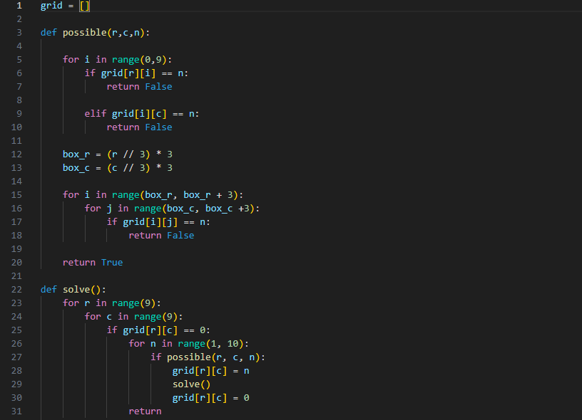
Example on automation by making a sudoku solver

Slide 9
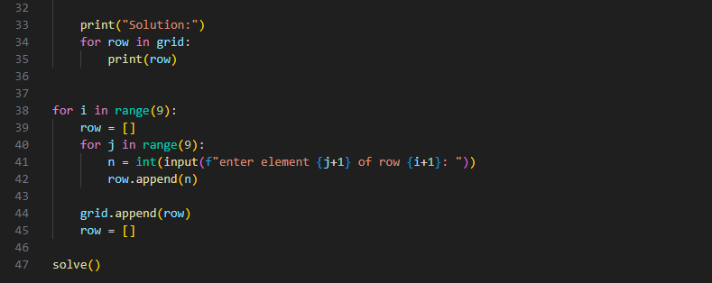

Slide 10
Is python statically typed or dynamically typed?
Python uses dynamic typing. This implies that rather than at compile time, variable types are decided during runtime. Python does not need you to specify variable types explicitly; instead, they are inferred from the values that are assigned to them. For instance, you won't have any problems assigning a string value to the same variable after first assigning an integer value to it.

Slide 11
Does python support object-oriented programming?
Object-oriented programming (OOP) is fully supported in Python. It enables the implementation of ideas like inheritance, encapsulation, and polymorphism as well as the definition of classes and objects.

Slide 12
Is python a high level language?
Python is regarded as a high-level language, indeed. Because high-level languages are meant to be simple to understand and write, developers may concentrate more on problem-solving and less on thinking about low-level concerns like memory management or instructions particular to a piece of hardware. Because of its simple and straightforward syntax, Python is suitable for both novice and seasoned developers.

Slide 13
Is python compiled or interpreted?
Python is an interpreted language. The Python interpreter reads and runs the code line by line when you run a Python script. Different from languages like C or C++, there is no separate compilation stage. Rather, the Python interpreter executes intermediate bytecode that has been translated from the original code. Since you can see the results of your code right away without having to compile it first, this simplifies development and debugging.

Slide 14
Part 2 - java

